Slide 1
Autism Spectrum Disorder (ASD) in Children
AYUSHI SIROTHIYA
NIKHIL WARIKOO
PAPRI BANERJEE
RASHMI NAYAK
SAMEER SITAL RAJ
TSION CHEGEN

Slide 2
Predictive analysis of Autism
Spectrum Disorder (ASD)

Slide 3
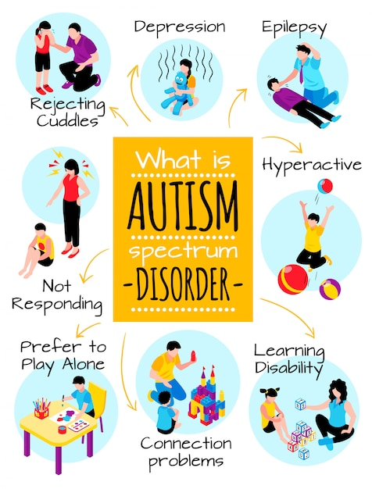
Autism In Children
Autism Spectrum Disorder (ASD) is a developmental disorder that affects communication, behavior, and social interaction. It is called a "spectrum" disorder because there is a wide range of symptoms and severity.

Slide 4
Problem Statement

Slide 5

The rising incidence of Autism Spectrum Disorder (ASD) in children underscores a critical and growing public health concern. This trend necessitates the development and implementation of robust diagnostic tools that can accurately identify ASD at an early stage, allowing for timely and tailored interventions. Early diagnosis and appropriate intervention strategies are crucial for improving developmental outcomes and quality of life for children with ASD and their families. This problem statement calls for a multidisciplinary approach that integrates advancements in medical research, technology, and therapeutic practices to create effective, accessible, and scalable solutions for the early detection and management of ASD.

Slide 6
Business Understanding

Slide 7
Business Understanding for Addressing Autism Spectrum Disorder (ASD)
Overview
The increasing prevalence of Autism Spectrum Disorder (ASD) among children presents both a significant challenge and a critical opportunity for the healthcare and technology sectors. The urgent need for effective diagnostic tools and intervention strategies opens a pathway for innovative business solutions that can make a substantial impact on the lives of affected individuals and their families.
Market Opportunity
Rising Incidence of ASD: With the growing number of ASD diagnoses, there is a substantial and expanding market for diagnostic and therapeutic services.
Early Intervention Demand: Early detection and intervention are key to improving outcomes for children with ASD, creating a high demand for reliable diagnostic tools and effective intervention programs.
Technological Advancements: Innovations in technology, including AI, machine learning, and wearable devices, present opportunities to develop advanced diagnostic and therapeutic solutions.
Healthcare Integration: The integration of ASD diagnostic and intervention tools into existing healthcare systems can improve accessibility and scalability, meeting the needs of a larger population.
Business Objectives
Develop Advanced Diagnostic Tools: Create and market diagnostic tools that leverage the latest technology to provide early, accurate, and accessible ASD diagnoses.
Design Effective Intervention Programs: Develop intervention strategies that are evidence-based, personalized, and adaptable to individual needs, enhancing developmental outcomes.
Enhance Accessibility: Ensure that diagnostic and intervention solutions are affordable and accessible to diverse populations, including underserved communities.
Collaborate with Stakeholders: Partner with healthcare providers, educational institutions, and research organizations to validate and implement solutions.
Measure Impact: Establish metrics to assess the effectiveness of diagnostic tools and intervention strategies, continuously improving based on feedback and outcomes.
Strategic Approach
Research and Development: Invest in R&D to stay at the forefront of technological and therapeutic advancements in ASD diagnosis and intervention.
Market Analysis: Conduct thorough market research to understand the needs of children with ASD, their families, and healthcare providers, tailoring solutions accordingly.
Product Development: Create user-friendly diagnostic tools and intervention programs that integrate seamlessly with existing healthcare and educational systems.
Regulatory Compliance: Ensure all products meet regulatory standards and guidelines for safety and efficacy.
Marketing and Outreach: Develop targeted marketing strategies to raise awareness about the importance of early ASD diagnosis and intervention, highlighting the benefits of your solutions.
Customer Support: Provide comprehensive support and training for users, including healthcare professionals, educators, and families, to maximize the effectiveness of your products.
Conclusion
Addressing the rising prevalence of ASD through innovative diagnostic and intervention solutions not only meets a critical public health need but also presents a substantial business opportunity. By focusing on advanced technology, accessibility, and collaborative partnerships, businesses can make a meaningful impact on the lives of children with ASD and their families while achieving sustainable growth and success.

Slide 8
Approach

Slide 9
1. Define the Problem and Objective
Objective: Develop machine learning models to classify children as having ASD or not, based on various input data.
Outcome: An accurate and reliable model that can be used for early diagnosis of ASD.
2. Data Collection
Clinical Data: Created a synthetic data using the data collected from Kaggle.com about ASD in Toddlers.
Cognitive Data: Communication skills, repetitive behavior, and sensory sensitivity.
Geographical Data: Information from genetic testing, if available.
Medical Complication Data: Jaundice and birth complications.
Socio-demographic Data: Age, gender, and other relevant demographic information.
3. Data Preprocessing
Data Cleaning: Handle missing values, remove the dupicates, and filter out irrelevant data.
Data Transformation: Normalize or standardize data, encode categorical variables, and create new features if necessary.
Data Augmentation: Generate additional data points using techniques like oversampling or SMOTE for imbalanced datasets, if necessary.
4. Exploratory Data Analysis (EDA)
Descriptive Statistics: Summarize the main characteristics of the data.
Visualization: Use charts and plots (e.g., histograms, scatter plots, box plots) to identify patterns and relationships.
Correlation Analysis: Examine correlations between features to understand dependencies and multicollinearity.
5. Feature Engineering
Feature Selection: Identify and select the most relevant features using techniques such as mutual information, correlation analysis, or feature importance from tree-based models.

Slide 10
6. Model Training
Training and Validation Split: Divide the data into training and validation sets (e.g., 80/20 split) to evaluate model performance.
Cross-Validation: Use k-fold cross-validation to ensure robustness and reduce overfitting.
Hyperparameter Tuning: Optimize model parameters using grid search, random search, or Bayesian optimization.
7. Model Evaluation
Evaluation Metrics:
Accuracy: Overall correctness of the model.
Precision and Recall: Important for imbalanced datasets.
F1 Score: Harmonic mean of precision and recall.
ROC-AUC: Performance across all classification thresholds.
Confusion Matrix: Detailed breakdown of true positives, false positives, true negatives, and false negatives.
8. Model Interpretation
Feature Importance: Identify which features contribute most to the model’s predictions.
Model Explainability: Ensure the model’s decision-making process is transparent and interpretable, especially for clinical use.
9. Validation and Testing
Clinical Trials: Validate the model in real-world clinical settings.
Feedback Loop: Collect feedback from healthcare providers and adjust the model, as necessary.
Regulatory Compliance: Ensure the model meets all relevant healthcare regulations and standards.

Slide 11
Data Understanding

Slide 12
Dataset Overview
The dataset is designed to assess Autism Spectrum Disorder (ASD) traits in children using various features. Each row represents an individual child, and the
dataset includes both behavioral assessments and demographic details. The goal is to understand the factors associated with ASD traits and to develop models
for early diagnosis.
Variable Descriptions
Q-CHAT-10 Scores
A1_Score: Score for "Does your child look at you when you call his/her name?"
Type: Boolean (Yes/No)
Description: Measures the child's response to their name being called.
A2_Score: Score for "How easy is it for you to get eye contact with your child?"
Type: Ordinal (Very easy, Easy, Difficult, Very difficult)
Description: Assesses the child's eye contact behavior.
A3_Score: Score for "Does your child point to indicate that s/he wants something? (e.g., a toy that is out of reach)"
Type: Boolean (Yes/No)
Description: Evaluates the child's use of pointing to express needs.
A4_Score: Score for "Does your child point to share interest with you? (e.g., pointing at an interesting sight)"
Type: Boolean (Yes/No)
Description: Assesses the child's use of pointing to share interest.
A5_Score: Score for "Does your child pretend? (e.g., care for dolls, talk on a toy phone)"
Type: Boolean (Yes/No)
Description: Evaluates the child's engagement in pretend play.
A6_Score: Score for "Does your child follow where you’re looking?"
Type: Boolean (Yes/No)
Description: Measures the child's ability to follow the gaze of others.
A7_Score: Score for "If you or someone else in the family is visibly upset, does your child show signs of wanting to comfort them? (e.g., stroking hair, hugging them)"
Type: Boolean (Yes/No)
Description: Assesses the child's empathy and comforting behaviors.
A8_Score: Score for "Would you describe your child’s first words as:"
Type: Ordinal (Typical, Delayed, Advanced)
Description: Evaluates the child's language development.
A9_Score: Score for "Does your child use simple gestures? (e.g., wave goodbye)"
Type: Boolean (Yes/No)
Description: Measures the child's use of gestures.
A10_Score: Score for "Does your child stare at nothing with no apparent purpose?"
Type: Boolean (Yes/No)
Description: Assesses the child's tendency to engage in purposeless staring.

Slide 13
Demographic and Additional Features
age:
Type: Numeric
Description: Age of the child in months.
gender:
Type: Categorical (Male/Female)
Description: Gender of the child.
ethnicity:
Type: String
Description: Ethnic background of the child.
jaundice:
Type: Boolean (Yes/No)
Description: Indicates whether the child was born with jaundice.
autism:
Type: Boolean (Yes/No)
Description: Indicates whether the child has been diagnosed with autism.
country_of_res:
Type: String
Description: The country where the child resides.
used_app_before:
Type: Boolean (Yes/No)
Description: Indicates whether the respondent has used the ASD screening app before.
result:
Type: Numeric (1-10)
Description: Total score from the Q-CHAT-10 questionnaire. Scores ≤ 3 indicate no ASD traits; scores > 3 indicate ASD traits.
age_desc:
Type: Categorical (4 – 11 years)
Description: Age description of the child.
relation:
Type: String
Description: The relationship of the person completing the test to the child (e.g., Parent, Relative, Health care professional, self, ?).
Class/ASD:
Type: Categorical (Yes/No)
Description: Indicates whether the child has ASD traits.

Slide 14
Additional Features
Communication_Skills:
Type: Categorical/Ordinal
Description: Assessment of the child's communication abilities.
Repetitive_Behaviors:
Type: Categorical/Ordinal
Description: Evaluation of repetitive behaviors observed in the child.
Sensory_Sensitivity:
Type: Categorical/Ordinal
Description: Measures the child's sensitivity to sensory inputs.
Coexisting_Conditions:
Type: Categorical/Ordinal
Description: Indicates the presence of any coexisting medical or psychological conditions.
Birth_Complications:
Type: Boolean (Yes/No)
Description: Indicates if there were any complications during birth.
Early_Development_Delays:
Type: Boolean (Yes/No)
Description: Indicates if there were any delays in early developmental milestones.
Family_History_ASD:
Type: Boolean (Yes/No)
Description: Indicates if there is a family history of ASD.
Data Exploration and Insights
Behavioral Patterns: Analyze the responses to the Q-CHAT-10 questions (A1_Score to A10_Score) to identify common behavioral patterns associated with ASD traits.
Demographic Influence: Examine how demographic factors such as age, gender, ethnicity, and country of residence correlate with ASD traits.
Family History and Medical Background: Investigate the impact of family history of ASD, medical conditions like jaundice, and birth complications on the likelihood of ASD traits.
Score Distribution: Study the distribution of Q-CHAT-10 scores and their relationship with the class variable to understand scoring patterns.
Respondent Analysis: Assess if the relationship of the respondent to the child (e.g., parent, caregiver) affects the responses and screening outcomes.
Coexisting Conditions: Analyze the presence of coexisting medical or psychological conditions and their impact on the child’s ASD traits.
Communication and Behavior: Explore the relationships between communication skills, repetitive behaviors, and sensory sensitivity with ASD traits.

Slide 15
Summary of the Dataset

Slide 16
The dataset consists of 30,000 entries and 28 columns, each representing different attributes of the children being analysed. These attributes can be categorized into numerical and categorical features.
Key Features:
Demographic Information:
age: The age of the child.
gender: The gender of the child.
ethnicity: The ethnic background of the child.
country_of_res: The country of residence.
Behavioral Scores: A1_Score to A10_Score: Scores from various behavioral assessments, each taking binary values (0 or 1).
Medical and Family History:
jaundice: Indicates if the child had jaundice at birth.
autism: Indicates if there is a family history of autism.
used_app_before: Indicates if the child has used an autism screening app before.
Communication_Skills, Repetitive_Behaviors, Sensory_Sensitivity, Coexisting_Conditions, Birth_Complications, Early_Development_Delays, Family_History_ASD: Various attributes indicating the child’s medical and developmental history.
Target Variable:
Class/ASD: The target variable indicating the diagnosis of Autism Spectrum Disorder (YES for diagnosed, NO for not diagnosed).
Conclusion: The dataset provides a comprehensive collection of features that can be used to predict ASD in children. Proper preprocessing and careful model selection are crucial to achieving accurate predictions, which can significantly aid in early diagnosis and intervention for children with ASD.

Slide 17
Exploratory Data Analysis

Slide 18
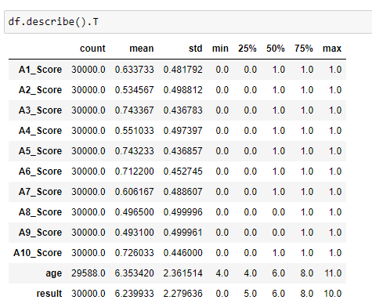
Exploratory Data Analysis (EDA) is an approach to analyzing data sets to summarize their main characteristics, often with visual methods. It is a critical step in the data analysis process that helps in understanding the data, uncovering patterns, identifying anomalies, and testing hypotheses.
Descriptive Statistics – Numerical Values
Score Distribution:
The scores (A1_Score to A10_Score) appear to be binary or categorical, primarily taking values of 0 or 1.
The mean values suggest that some scores are generally higher on average (e.g., A3_Score, A5_Score, A10_Score) compared to others (e.g., A2_Score, A8_Score, A9_Score).
Age Distribution:
Age has a moderate spread with most values concentrated around 4 to 8 years, and a few reaching up to 11 years.
Result Distribution:
The result variable shows a wide range from 0 to 10, with a mean around 6.24.
The distribution is relatively symmetric with a similar 25th percentile, median, and 75th percentile, indicating that the result is well distributed around the mean.

Slide 19
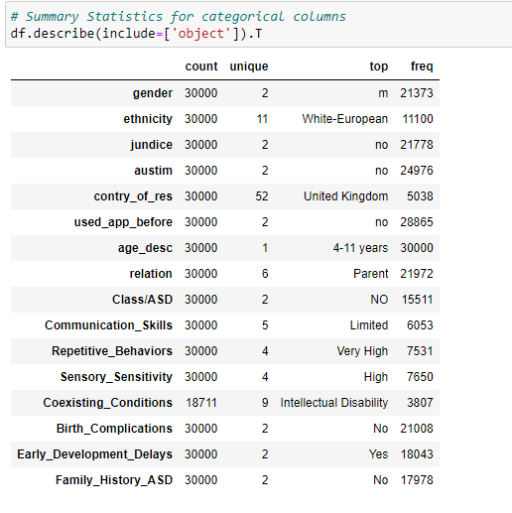
Descriptive Statistics – Categorical Values
Gender Distribution:
The dataset is skewed towards males (21,373) compared to females (8,627).
Ethnicity Distribution:
The majority of participants are White-European (11,100), with other ethnicities being less represented.
Health and Medical History:
Most participants did not have jaundice (21,778) or autism (24,976).
A significant number of participants did not have birth complications (21,008) or family history of ASD (17,978).
A large number had early development delays (18,043).
Application Usage:
Most participants had not used the app before (28,865).
Age and Relation:
All participants fall within the '4-11 years' age range.
Most participants' relations are identified as 'Parent' (21,972).
Autism Spectrum Disorder (ASD):
A notable number of participants are classified as not having ASD (15,511).
Communication and Behavior:
Communication skills are predominantly 'Limited' (6,053).
Repetitive behaviors are 'Very High' (7,531), and sensory sensitivity is 'High' (7,650).
Coexisting Conditions:
Intellectual disability is the most common coexisting condition (3,807) among the 18,711 participants who provided this information.

Slide 20
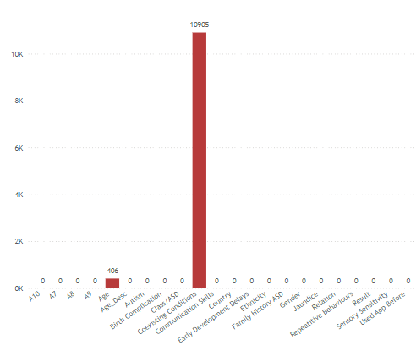
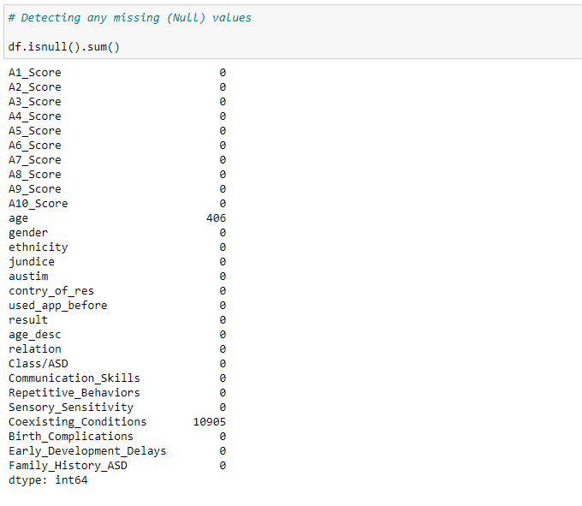
Finding the Null Values
We can observe that the columns ‘Age’ and ‘Coexisting Conditions’ contain missing values.
Age column contains 406 (1.35%) missing values.
Coexisting Conditions column contains 10,905 (36.35%) missing values.
Visualization is created on Power BI.

Slide 21
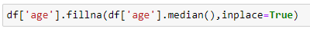
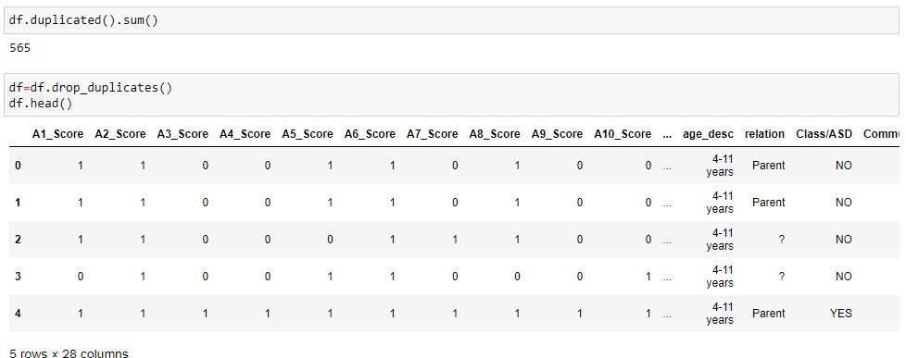
Null Value Imputations:
Given that the percentage of missing values in ‘Age’ column is relatively low (1.35%), one straightforward approach is to impute the missing values with the median age.
Since 'Coexisting Conditions' is a categorical variable, imputation with the most frequent value (mode) is a common approach.
Detecting & Removing Duplicates:
The dataframe ‘df’ contains 565 duplicate values. We are dropping these duplicates from the dataframe. The total number of rows remaining is 29,435.

Slide 22
Data Visualisation
Data Visualization has been performed on Power BI Desktop and published on Power BI Service (Public Web)
Link to the interactive dashboard: Autism in Children (EDA)

Slide 23
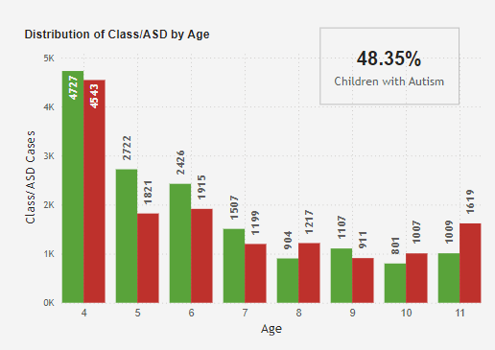
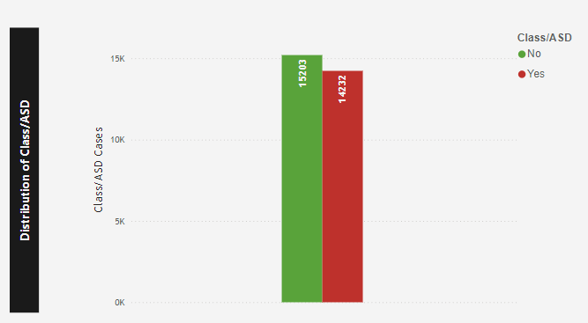
We can observe from the bar graph of the target variable, Class/ASD, that out of a total of 29,435 cases, there are 14,232 cases classified as autistic. This accounts for approximately 48.35% of the total cases.
The significantly higher count of children aged 4 compared to other ages suggests that age 4 might be a critical age for autism diagnosis. This could imply that parents or healthcare providers are more likely to seek diagnostic evaluation for children around this age, or that developmental signs of autism become more noticeable or concerning at this stage.

Slide 24
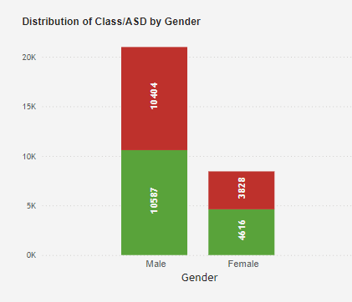
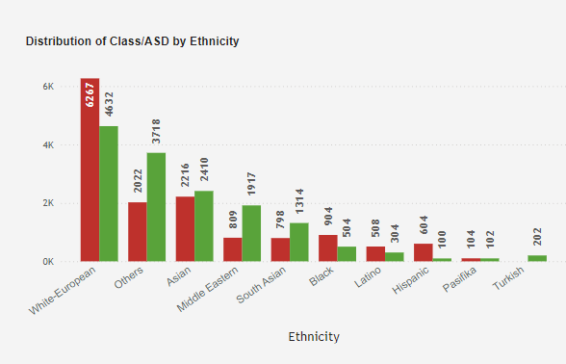
The graph shows a significant gender disparity in the prevalence of autism among children. Specifically, the number of male children diagnosed with autism (10,404) is substantially higher than the number of female children diagnosed with autism (3,828). This suggests that autism is more commonly diagnosed in male children compared to female children.
Majority Ethnicity: White European children make up the largest ethnic group among the children with autism in the dataset, comprising about 21.3% of the total.
Minority Ethnicity: Asian children with autism represent a smaller proportion, about 7.5% of the total.

Slide 25
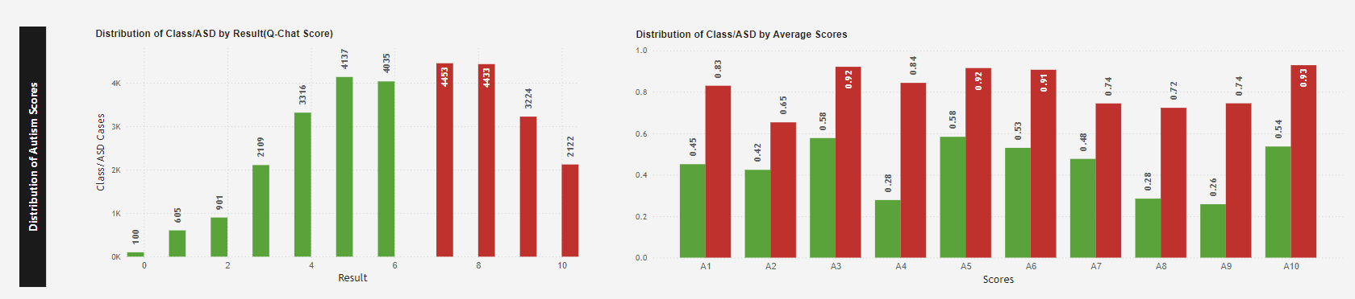
When the Q-Chat scores exceed 7, there is a noticeable increase in the detection of autism cases, with a significant spike exactly at the score of 7. This suggests that a Q-Chat score of 7 or higher is a strong indicator of autism in children. Therefore, focusing diagnostic efforts on children with scores at or above this threshold could improve early detection and intervention strategies.
The distribution of average scores for A1 to A10 in the graph shows high levels of autism traits in children. This suggests that these specific questions are particularly effective at identifying traits associated with autism. Therefore, these questions should be emphasized in screening tools to improve the accuracy and early detection of autism in children.

Slide 26
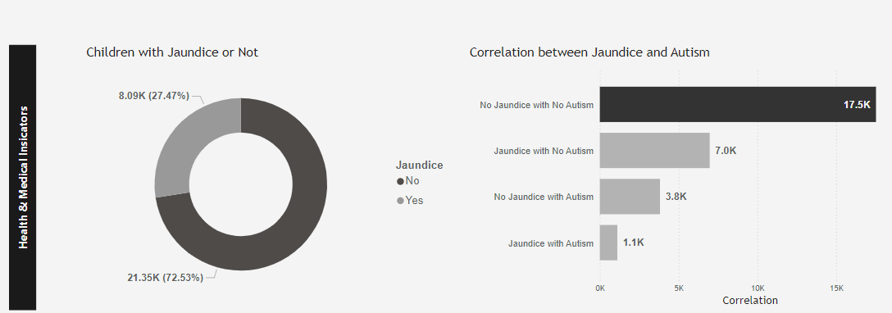
The graph shows that out of a total of 29,435 children in the dataset, 8,086 children have jaundice. This indicates that approximately 27.5% of the children with autism in the dataset also have jaundice. This could suggest a potential correlation between jaundice and autism in children, which may warrant further investigation.
The presence of jaundice in a significant number of autistic cases (1,111 out of 29,435) suggests a potential correlation worth further investigation. This could imply that jaundice might be a contributing factor or a common variable in cases of autism.

Slide 27
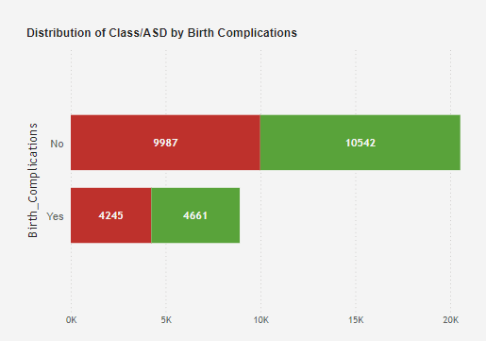
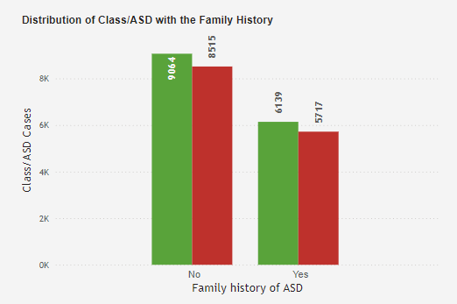
Approximately 14.42% of the children in the dataset have both birth complications and autism, indicating a notable correlation between birth complications and autism.
Approximately 19.4% of the children with ASD in the dataset have a family history of ASD.
Approximately 28.9% of the children with ASD in the dataset do not have a family history of ASD.
A significant proportion of children with ASD do not have a family history, which might suggest other contributing factors beyond family genetics. The data indicates that while family history is a factor, it does not account for the majority of ASD cases in this dataset.

Slide 28
Approximately 14.42% of the children in the dataset have both birth complications and autism, indicating a notable correlation between birth complications and autism.
Approximately 19.4% of the children with ASD in the dataset have a family history of ASD.
Approximately 28.9% of the children with ASD in the dataset do not have a family history of ASD.
A significant proportion of children with ASD do not have a family history, which might suggest other contributing factors beyond family genetics. The data indicates that while family history is a factor, it does not account for the majority of ASD cases in this dataset.

Slide 29
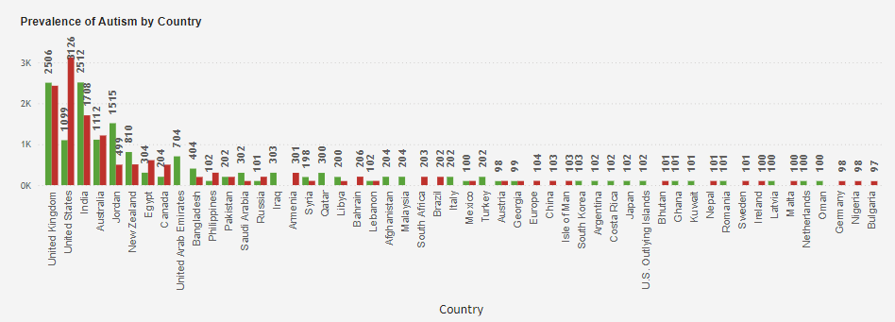
USA: Approximately 10.62% of the autism cases in the dataset are from the USA. This is the highest among the three countries mentioned, indicating that a significant portion of the autism cases in the dataset come from the USA.
UK: The UK accounts for approximately 8.26% of the autism cases in the dataset. This is the second-highest percentage, suggesting that the UK also has a notable number of autism cases in this dataset.
India: India has approximately 5.80% of the autism cases in the dataset. This is the lowest among the three countries mentioned but still represents a significant number of cases.
The USA has the highest percentage of autism cases among the three countries, followed by the UK and then India. This could be due to various factors such as population size, diagnostic criteria, healthcare accessibility, and awareness levels.

Slide 30
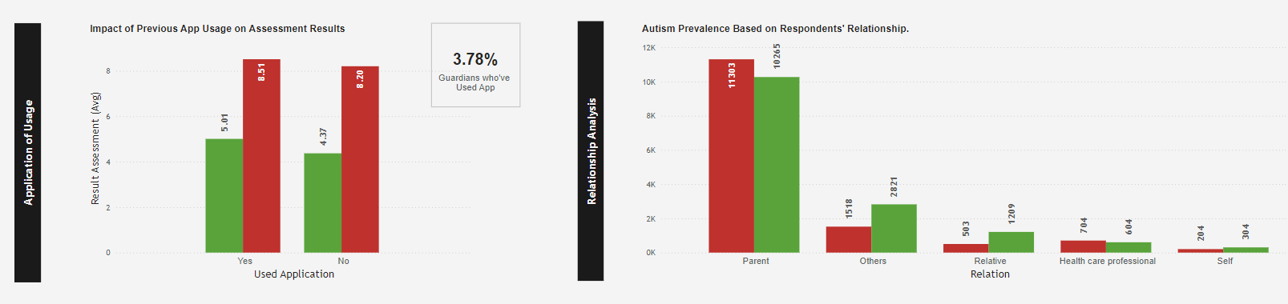
Children who had not used an app before scored slightly higher (8.51) on the Q-CHAT than those who had used an app before (8.20). This suggests that, on average, children who had used an app earlier show marginally lower Q-CHAT scores, which might indicate a slightly lower likelihood of autism as compared to those who had not used an app.
The largest group is parents (11,303 respondents), indicating that this population has a significant interest or stake in autism-related issues. This suggests that insights gathered from this group may be more representative of familial experiences.

Slide 31
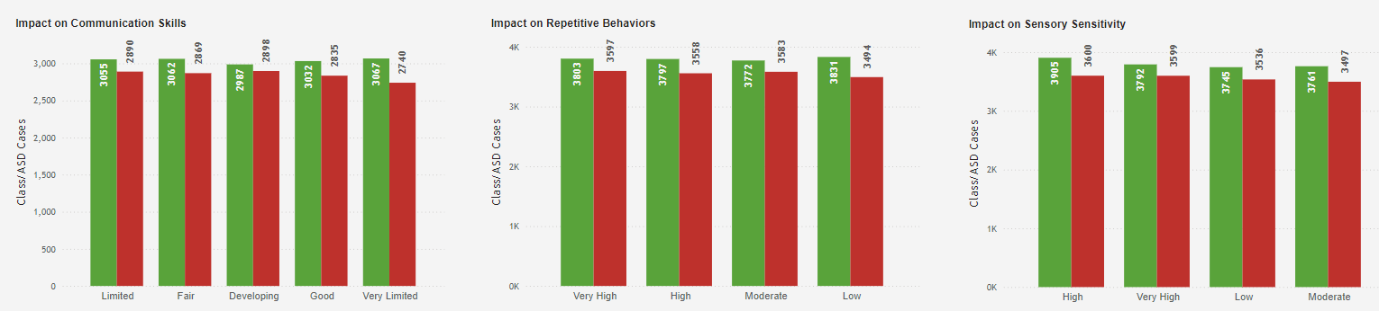
This balanced distribution of communication skills among children with autism presents both challenges and opportunities for intervention. By leveraging detailed demographic and intervention data, targeted strategies can be developed to enhance communication abilities across all categories.
The relatively similar counts in the very high (3597), high (3583), and moderate (3583) categories indicate that a significant portion of children display substantial repetitive behaviors. This highlights the need for awareness and targeted support across all levels.
Given that about 12.2% of the children fall into each of the higher behavior categories, intervention programs should be designed to address the specific needs of children exhibiting very high and high repetitive behaviors, as they may require more intensive support.
The higher numbers in the high and very high categories suggest that many children experience significant sensory sensitivities. This may have implications for support strategies, as children with high sensitivity might require tailored interventions.
The concentration of children in the high and very high categories indicates a need for targeted interventions. Programs focusing on sensory regulation and coping strategies could be beneficial for this group.

Slide 32
Data Preparation

Slide 33
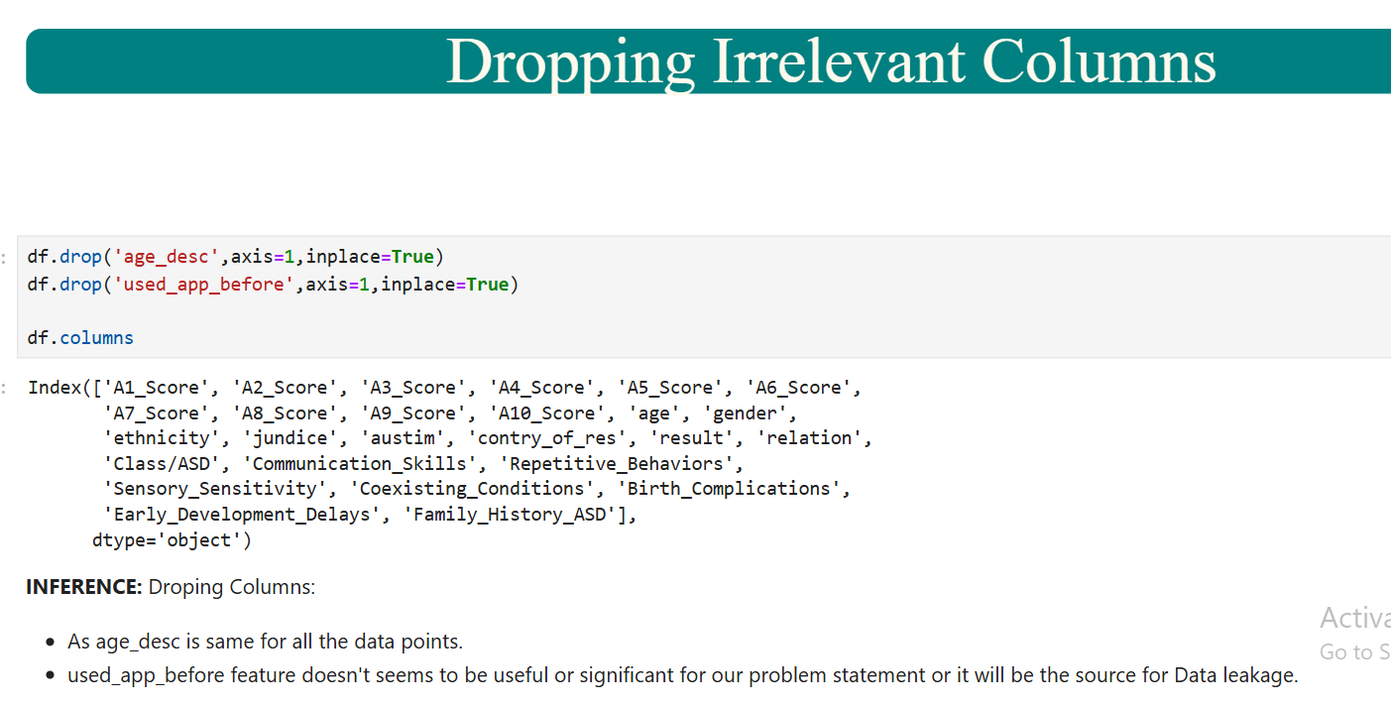
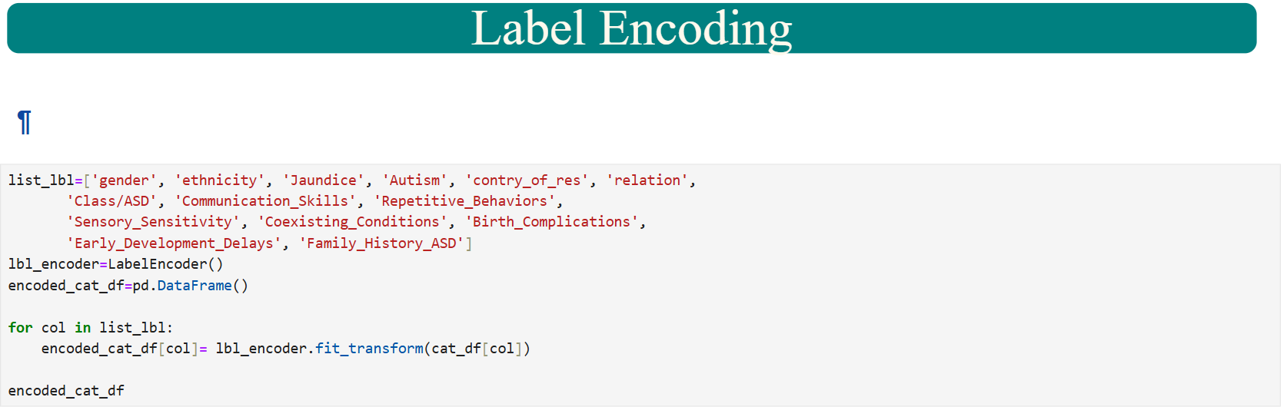
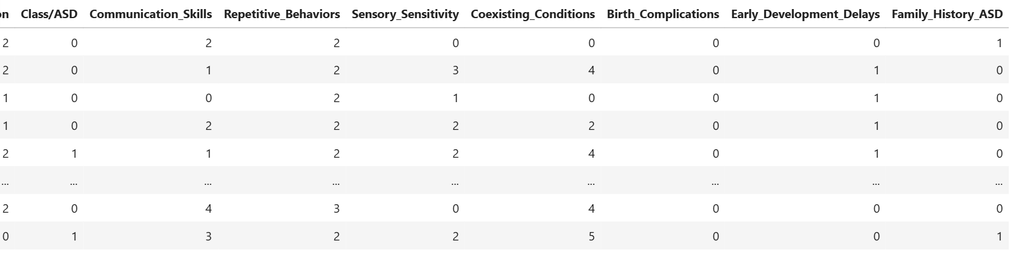
Data formatting & Encoding on features
Dropped irrelevant columns as it will impact model performance
The categorical features are encoded using label encoder before proceeding to model building

Slide 34
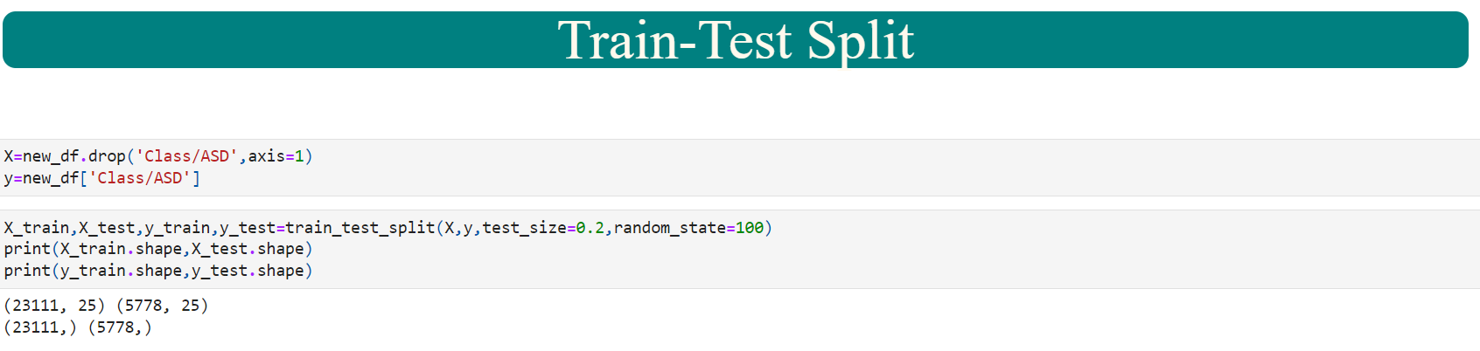
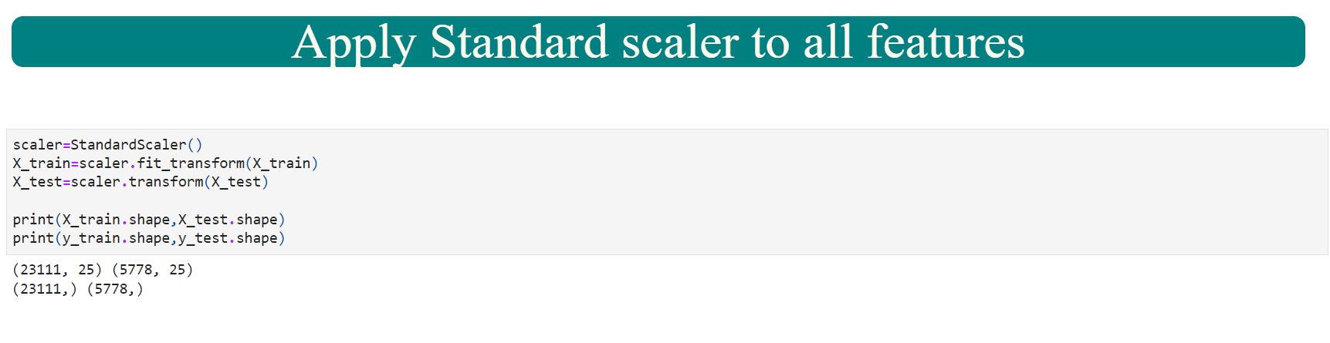
Splitting the Data in Test and Train
The concatenated dataframe was split was split into Train and Test data (80,20) keeping random state as 100. The target is ‘Class/ASD’
The features were scaled using StandardScalar before proceeding to Model Building

Slide 35
Data Modelling

Slide 36
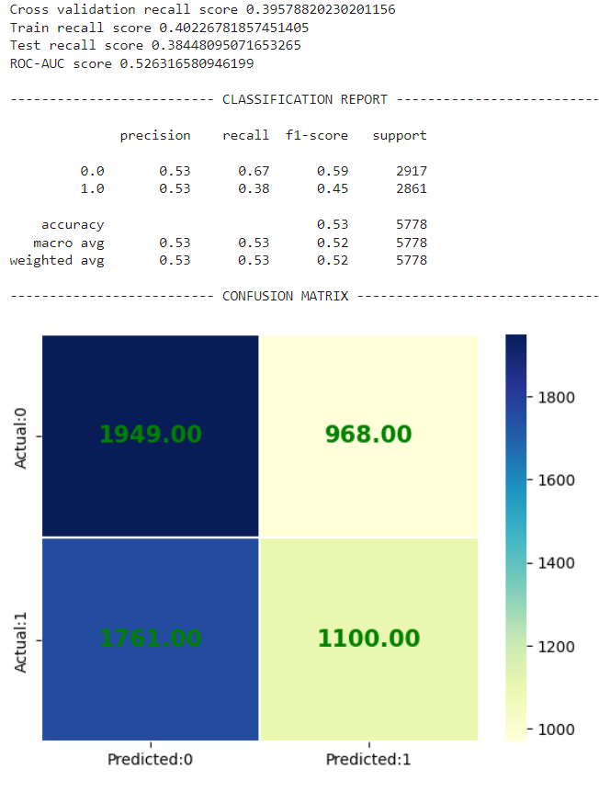
Logistic Regression
Classification Report
Confusion Matrix
The Accuracy for this model is 54%.
The recall is also 55%.
The Cross Validation Recall score is 42%.

Slide 37
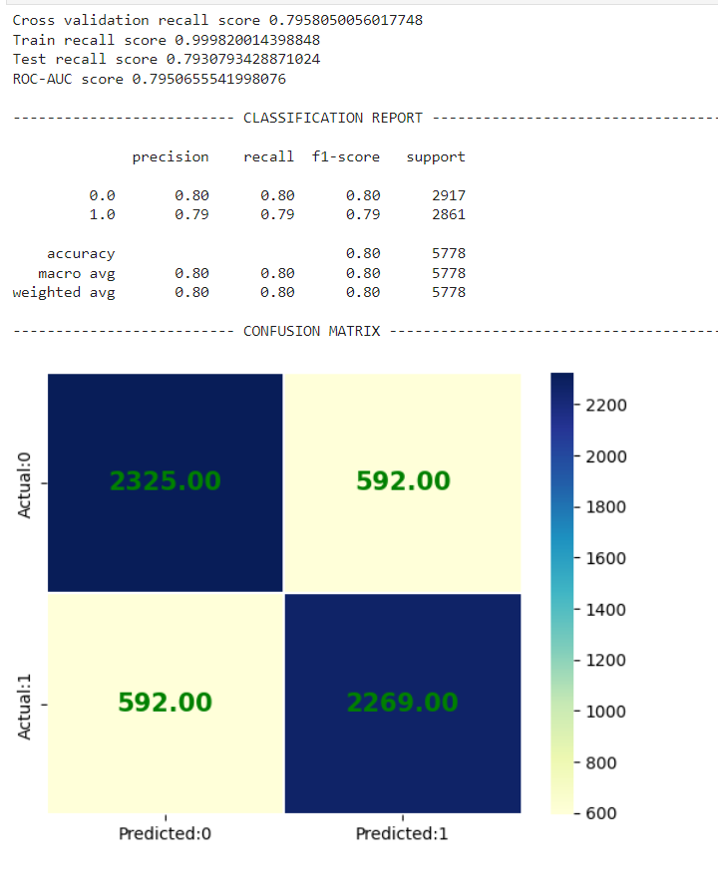
Decision Tree
Classification Report
Confusion Matrix
The Accuracy for this model is 80%.
The recall is also 80%.
The Cross Validation Recall score is 80%.

Slide 38
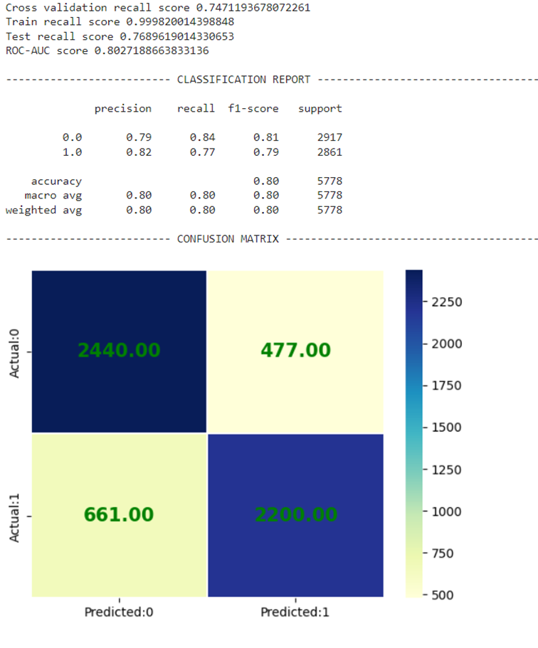

Random Forest
Classification Report
Confusion Matrix
The Accuracy for this model is 80%.
The recall is also 80%.
The Cross Validation Recall score is 75%.

Slide 39
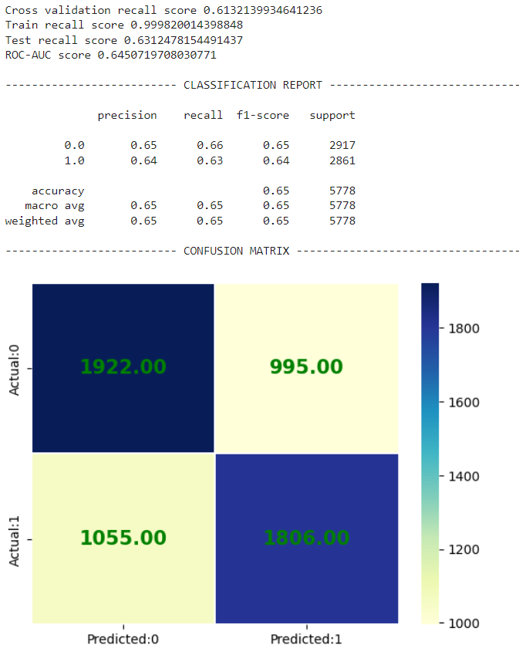
Ada Boost
Classification Report
Confusion Matrix
The Accuracy for this model is 65%.
The recall is also 65%.
The Cross Validation Recall score is 61%.

Slide 40
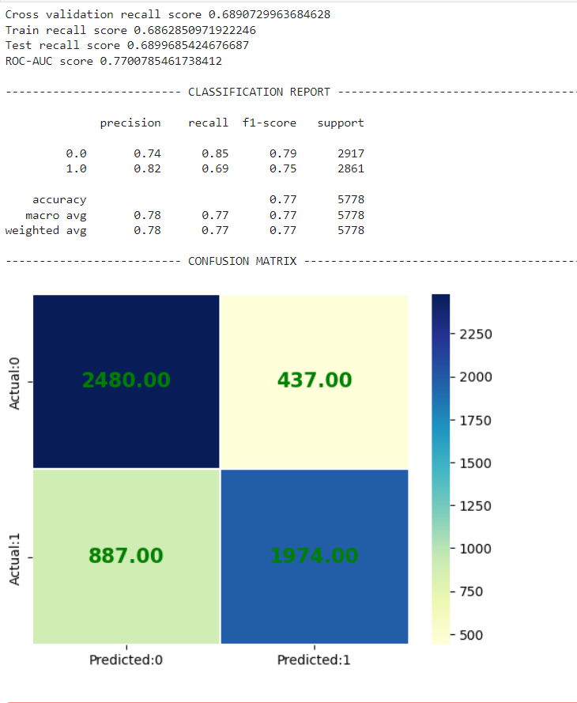
Gradient Boost
Classification Report
Confusion Matrix
The Accuracy for this model is 77%.
The recall is 69%.
The Cross Validation Recall score is 69%.

Slide 41
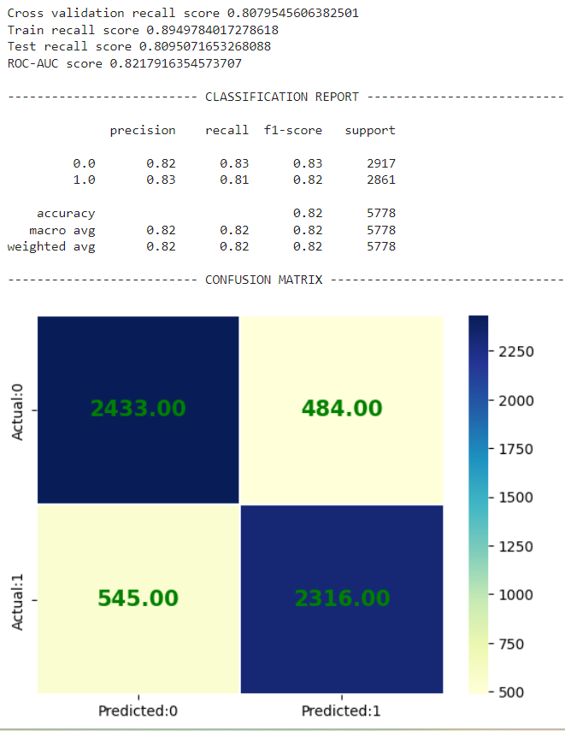
XG Boost
Classification Report
Confusion Matrix
The Accuracy for this model is 82%.
The recall is 81%.
The Cross Validation Recall score is 81%.
This is the Best Model Out of the All till now. We still proceed ahead to improvise this Model by doing Repeated Kfold for Logistic & Gradient boosting and GridsearchCV on logistic and RandomsearchCV on Gradient and XG boost

Slide 42
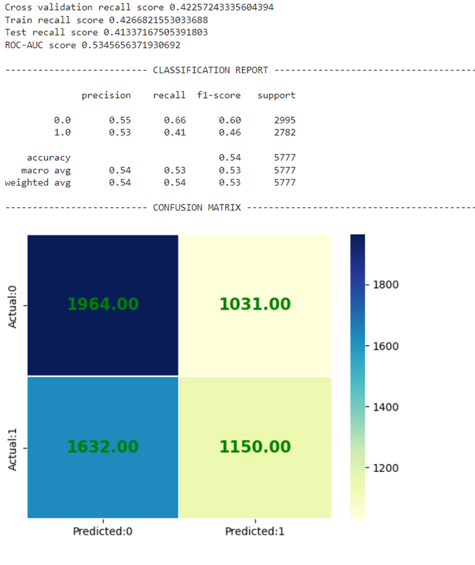
Logistic Regression after Repeated K-Fold
Classification Report
Confusion Matrix
The Accuracy for this model is 54%.
The recall is also 53%.
The Cross Validation Recall score is 42%.

Slide 43
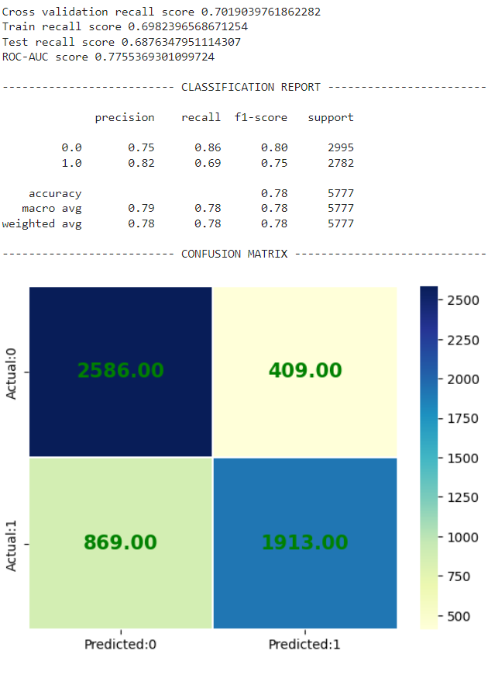
Gradient Boosting after Repeated K-Fold
Classification Report
Confusion Matrix
The Accuracy for this model is 78%.
The recall is 69%.
The Cross Validation Recall score is 71%.

Slide 44
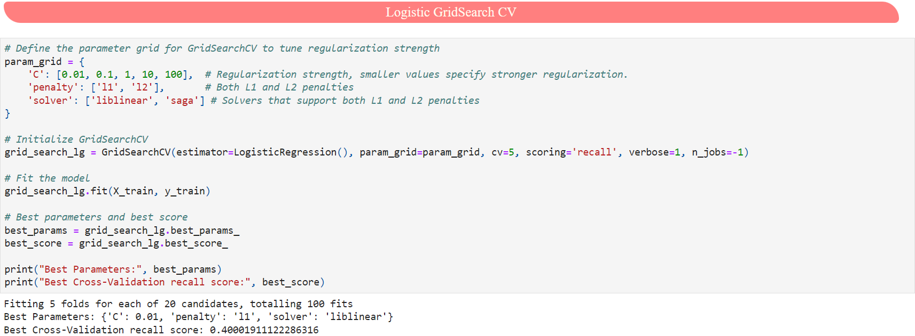
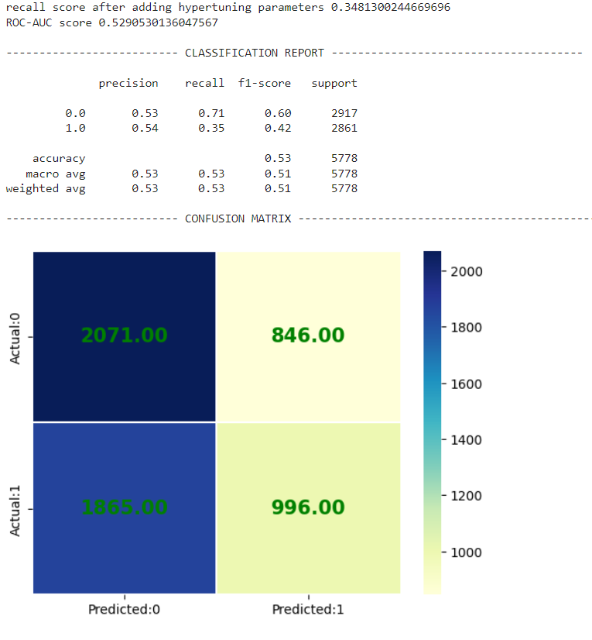
Logistic Regression Grid SearchCV
Classification Report
Confusion Matrix

Slide 45
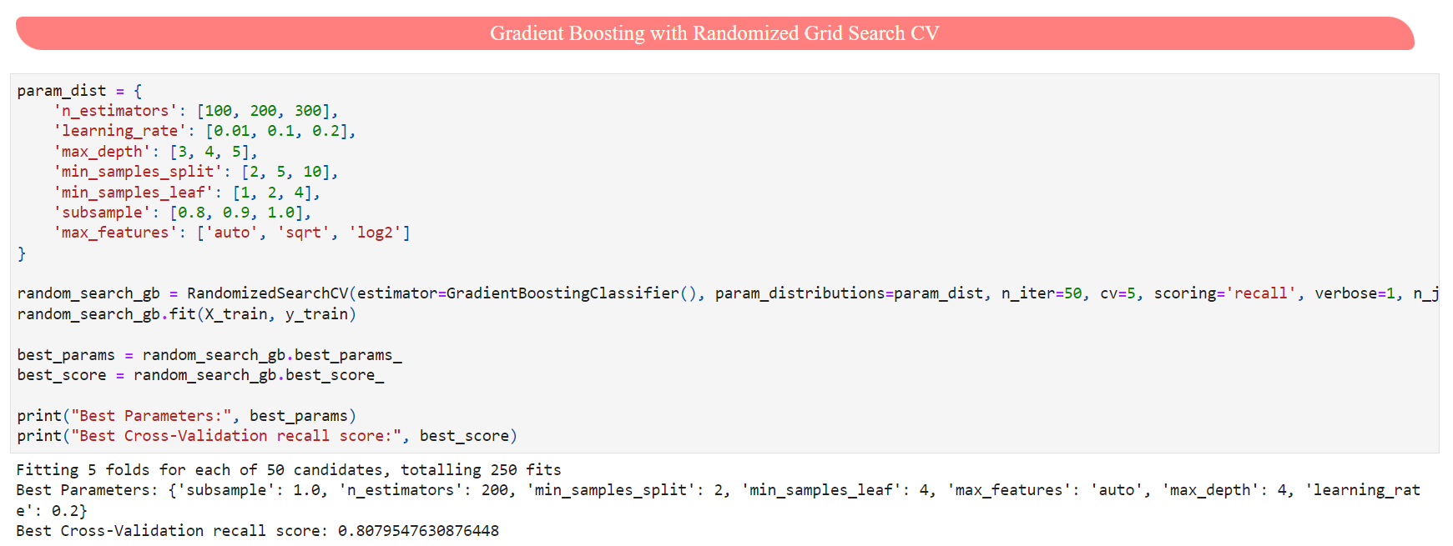
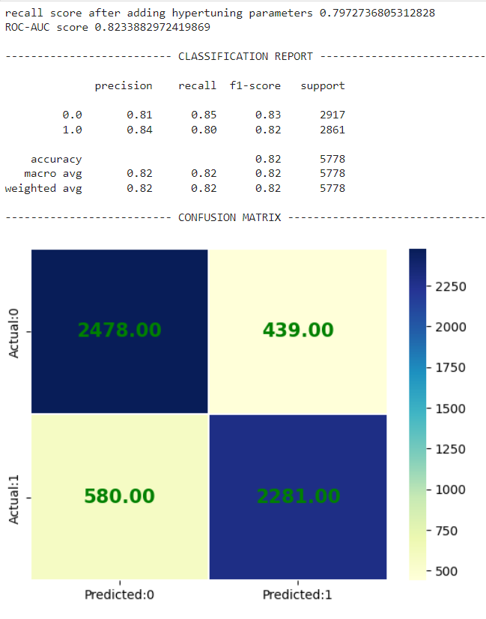
Gradient boosting with RandomizedSearchCV
Classification Report
Confusion Matrix

Slide 46
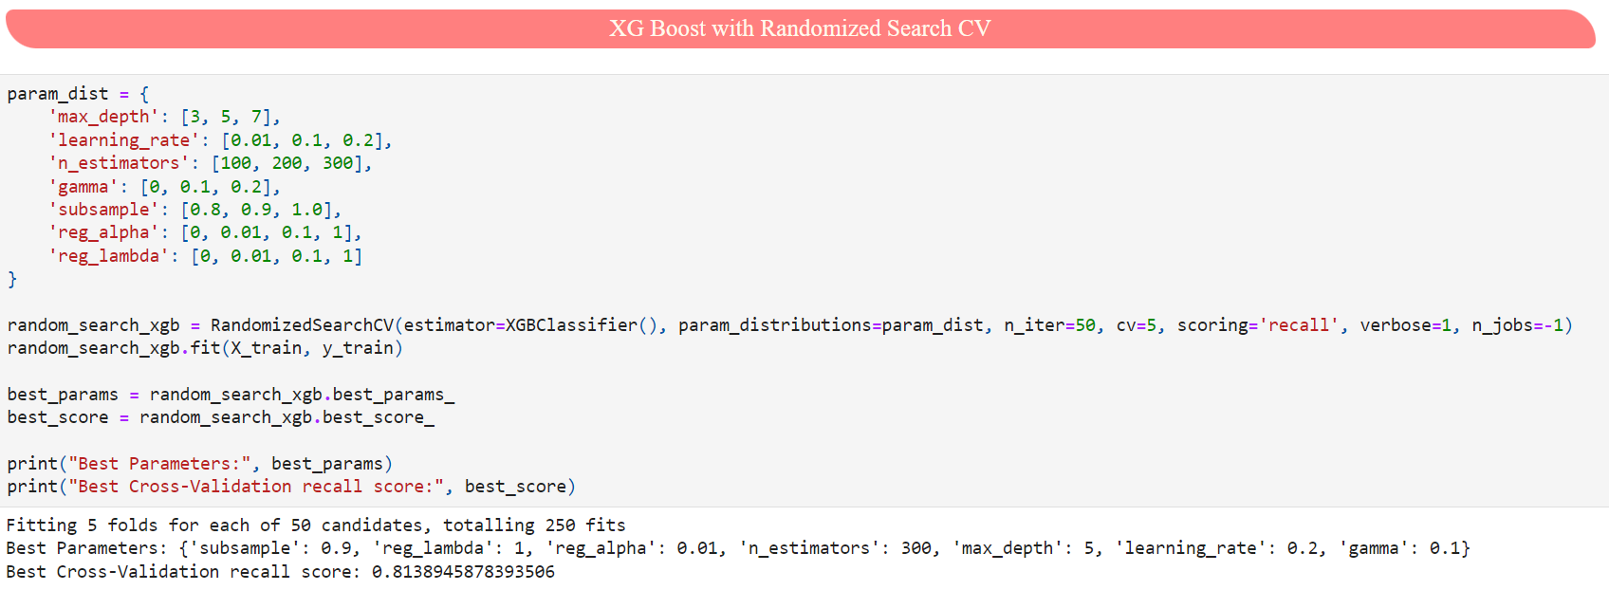
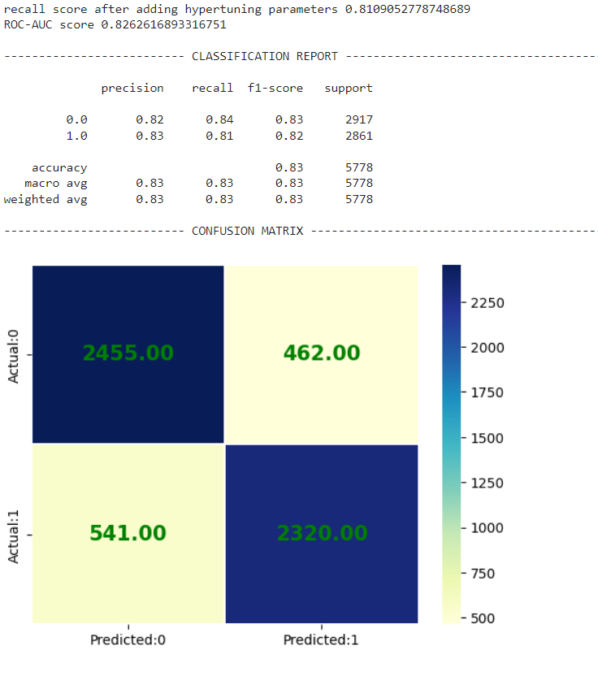
XG Boosting with Randomized Grid SearchCV
Classification Report
Confusion Matrix

Slide 47
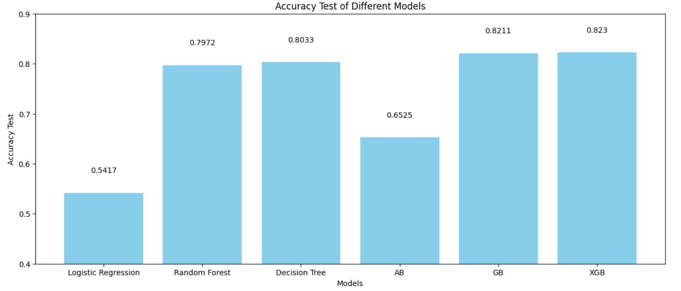
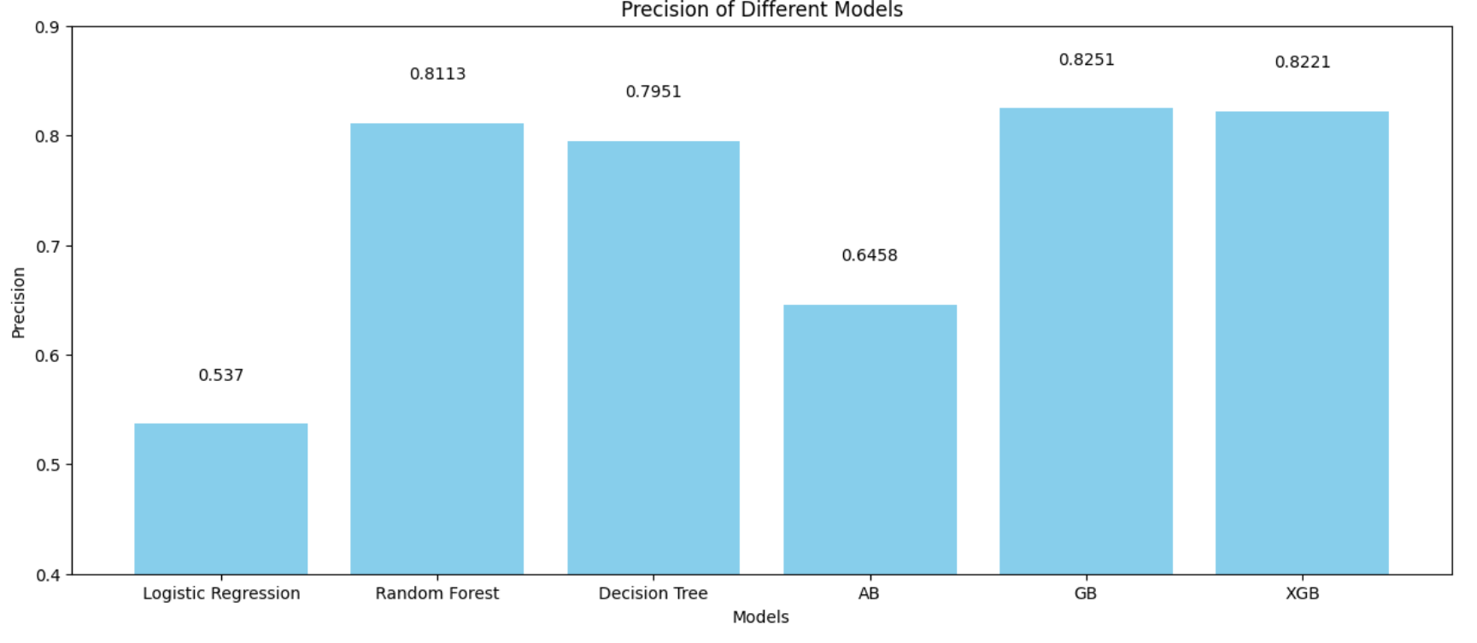
Summary of All the Models
Accuracy of All the Models
The accuracy of XGBoost Model is (82.3%) followed by Gradient Boost(82.1%), Decision Tree(80.3%), Random Forest (79.7%), Ada Boost(65.2%) and the least is for Logistic Regression Model(54.1%)
Precision of All the Models
The Gradient Boosting Model has the highest Precision of 82.5% indicating a relatively high proportion of correct positive predictions.

Slide 48
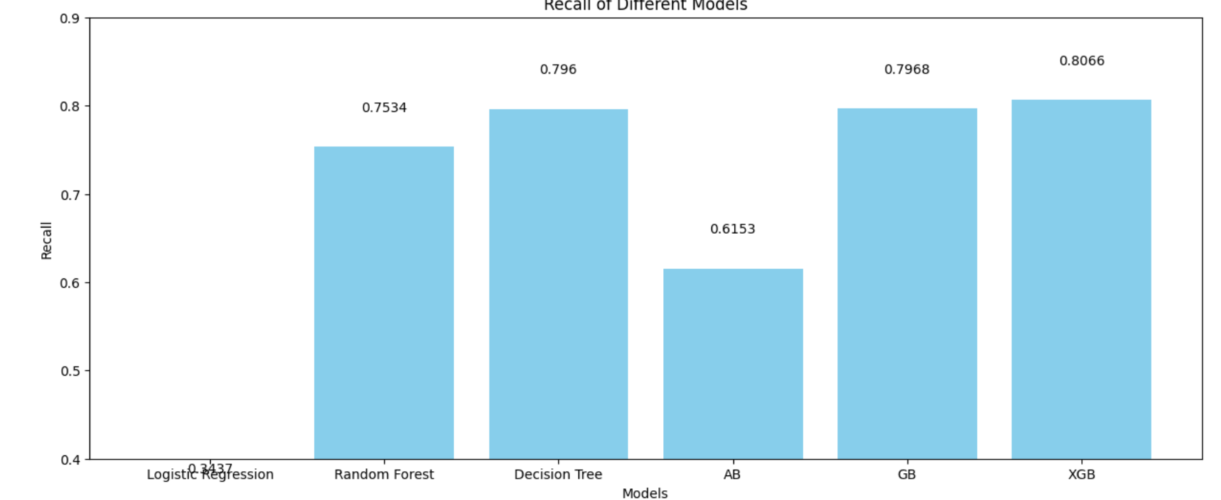
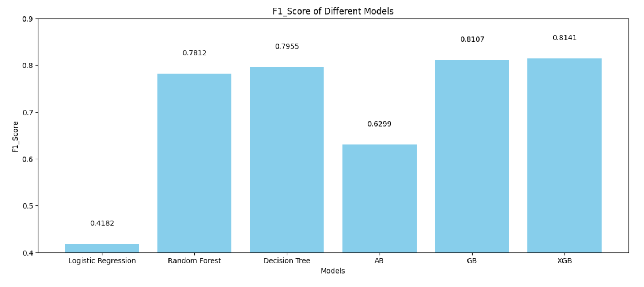
Summary of All the Models
Recall of All the Models
XG Boost has the recall at 80.6%, indicating its ability to identify a portion of the actual positive instances.
Better the recall, efficient is our Model.
F1_Score of All the Models
XG Boost achieves the highest F1 score of 81.4%, which balances precision and recall.

Slide 49
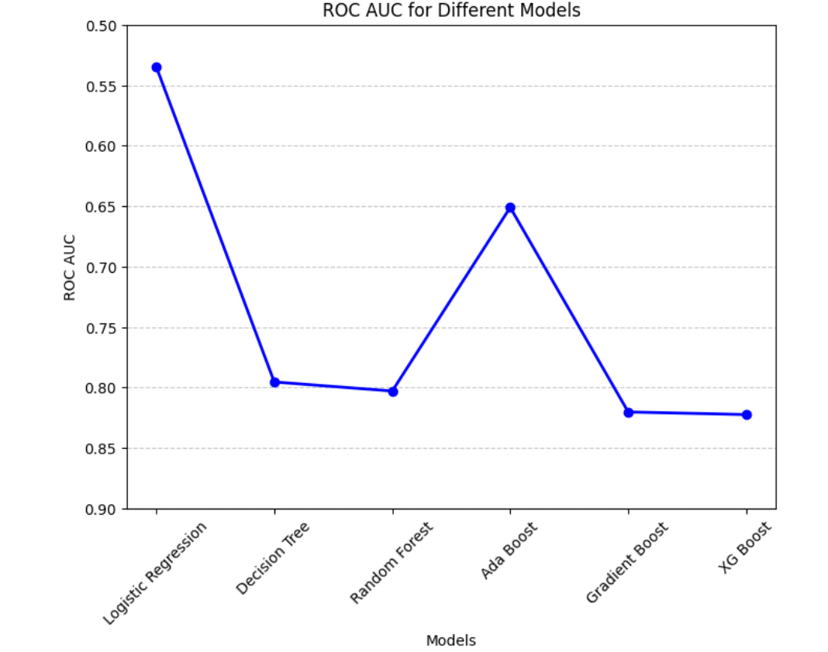
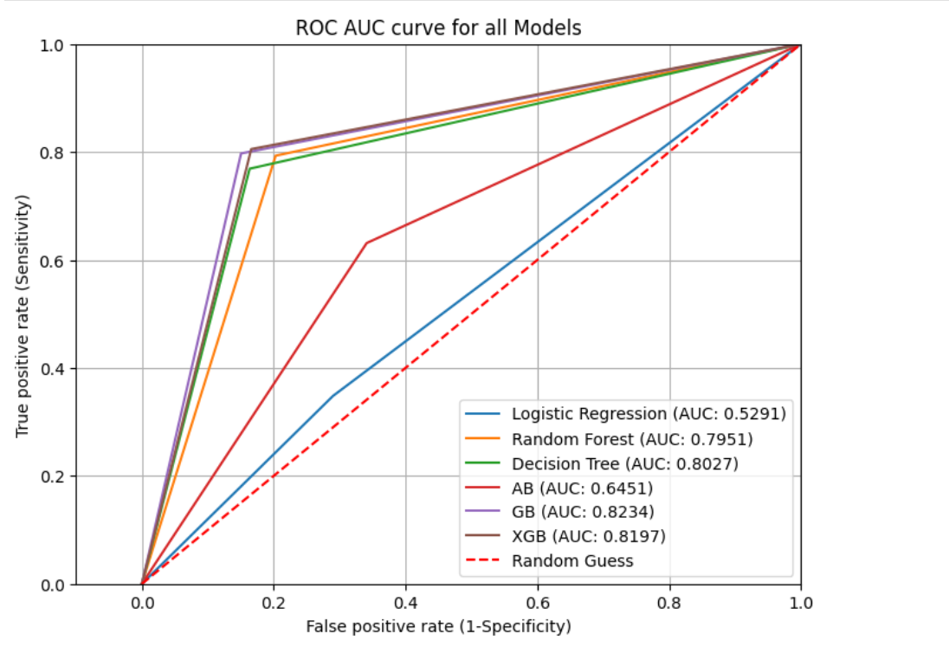
ROC AUC Curves of All the Models
XG Boost has the highest AUC score of 82%, which indicates the model is best in comparison to other Models.

Slide 50
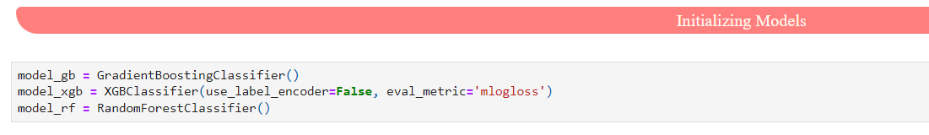
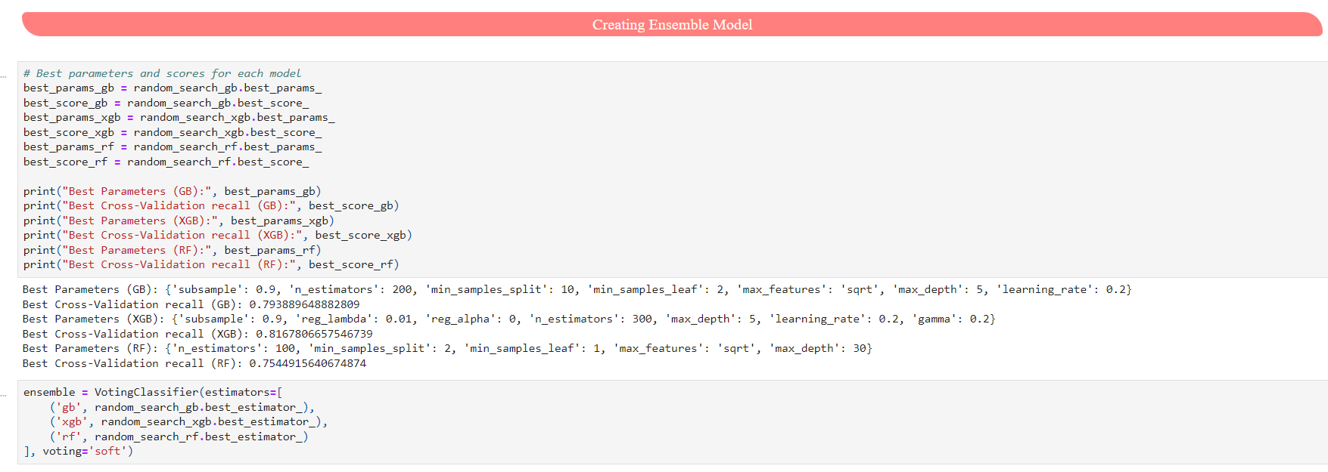
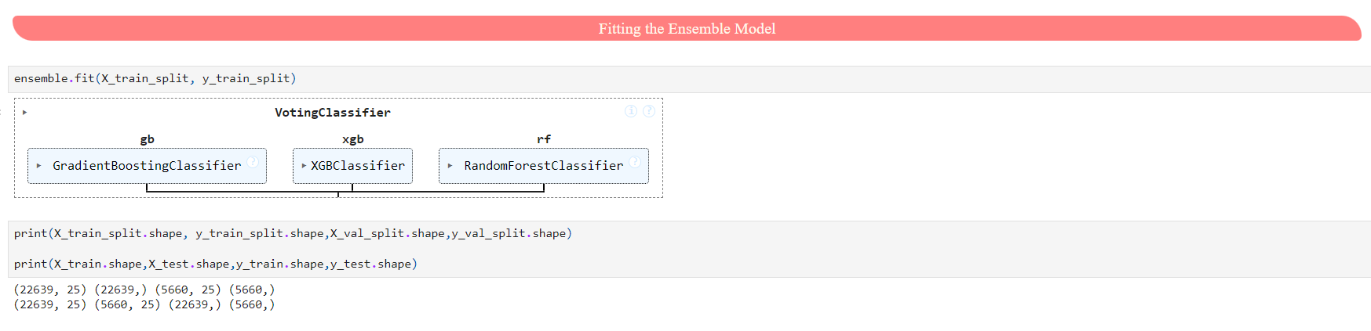
Ensemble Model
Initializing ensemble Model using
We try to build an Ensemble Model which is combination on Random Forest, Gradient Boosting and XG Boost.
Creating ensemble Model using
Creating ensemble Model using

Slide 51
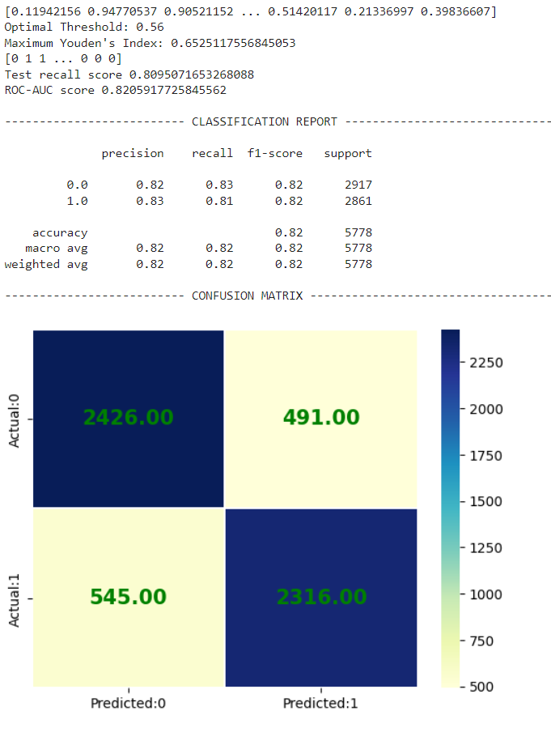
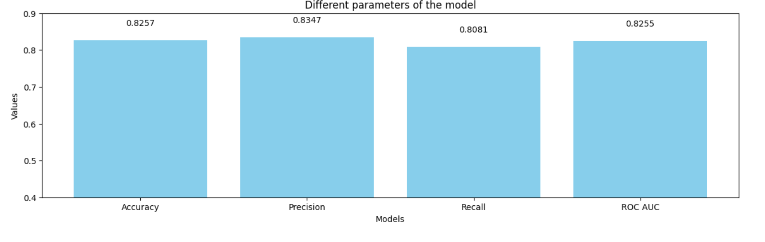
Ensemble Model
Ensemble Model: (Random Forest + Gradient Boost + XG Boost)
Confusion Matrix
Classification Report
With this Model which achieve Accuracy of 82.5%, Recall of 82% with threshold of 0.65.
The Confusion Matrix show FN(545) and FP(491) which lower when compared to the other Models.

Slide 52
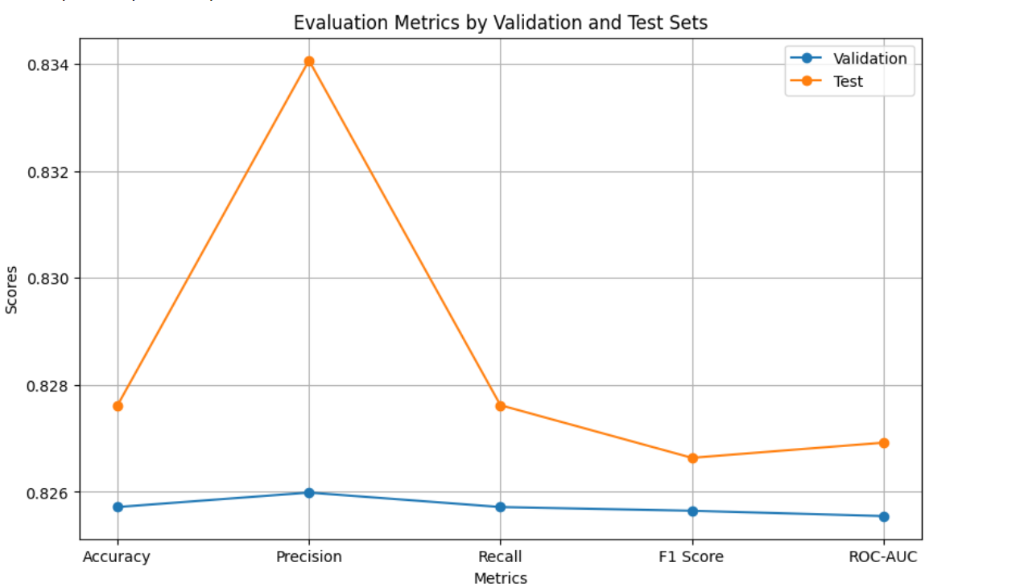
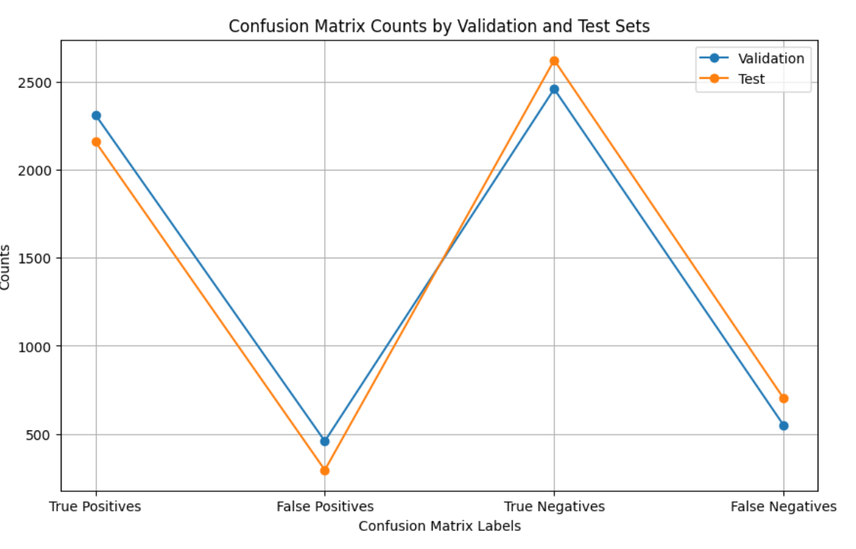
Predicting And Evaluating The Ensemble Model
We can infer from the Confusion Matrix Counts of Validation and Test that ensemble model is most accurate in predicting the positive Class/ASD.

Slide 53


Predicting And Evaluating The Ensemble Model
The ROC curve has the AUC score of 82.4% indicating this is most suitable model.

Slide 54


Important Features Impacting Class/ASD
The Country_of_Res has highest impact on Class/ASD followed by Ethnicity, Jaundice, Gender, Relation, Autism.
A1_Score to A10_Score have lowest impacts on Class/ASD

Slide 55
AYUSHI SIROTHIYA
NIKHIL WARIKOO
PAPRI BANERJEE
RASHMI NAYAK
SAMEER SITAL RAJ
TSION CHEGEN

